Slide 1
Bidding When Items’ Selling Price increases in Competitive Environment
Jhorman Arlex Perez Buendia, Veli Can Erdem, Sharang Kaul, Alexandros Nikolau

Slide 2
Scenario
A competitive environment, with bundles to sell by bidder having constantly increasing prices.
Compared to supply of items, it is expected to have some bundles increase in more than 300% value at the end.
The winner of the auction is the one with most credits minus a penalty of leftover items.

Slide 3
Strategy
Competitive prices to bid along the auction.
Adequate values for each of items with respect to their return values.
Selling at right time to maximize the profit.

Slide 4
Item Values
Considering the sell values at Auction B, the maximal value of item is defined hierarchically, as in Resource A first, then B, then C / D etc.
From each bundle, infer the value of the item from it. If it contains another item and the item’s value is already inferred, subtract the inferred value. If not so, choose one to put into hierarchy which decides which item’s value to infer first.

Slide 5
Item Values continued
Example: Both A and B is in AAB. Order of inference: A first where AAB is ignored, then B where AAB’s B value is calculated.
Calculate all B values per bundle it participates. Then, store the maximal value.
This value is used at both buying and selling of items.
Note that some other approaches are also viable than the ignoring a bundle, however considering the start prices of bundles, this is also appropriate.

Slide 6
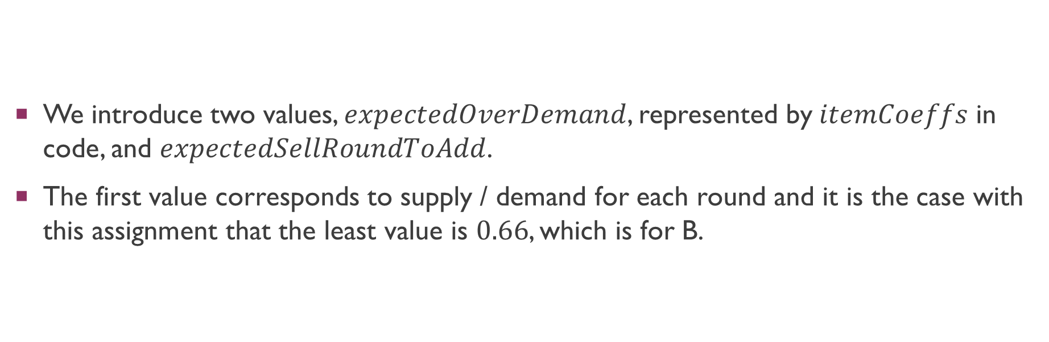
Buying an Item
We introduce two values, $expectedOverDemand$, represented by$itemCoeffs$ in code, and $expectedSellRoundToAdd$.
The first value corresponds to supply / demand for each round and it is the case with this assignment that the least value is $0.66$, which is for B.

Slide 7
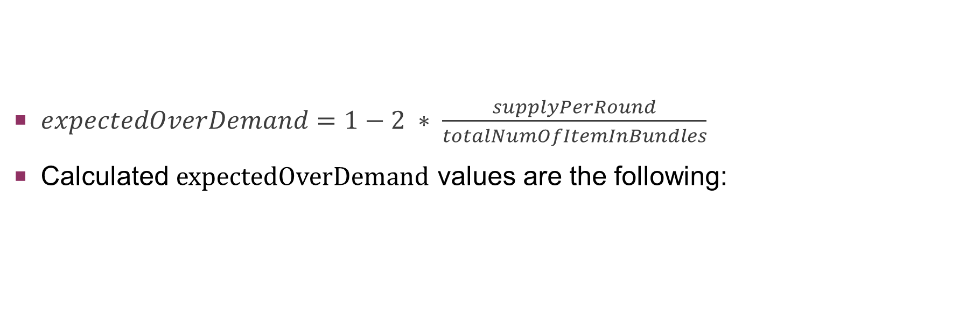
Expected Over Demand
$expectedOverDemand=1−2 ∗ \frac{supplyPerRound}{totalNumOfItemInBundles}$
Calculated expectedOverDemand values are the following:
A | B | C | D | E | F
0.87 | 0.66 | 0.94 | 0.94 | 0.97 | 0.93

Slide 8
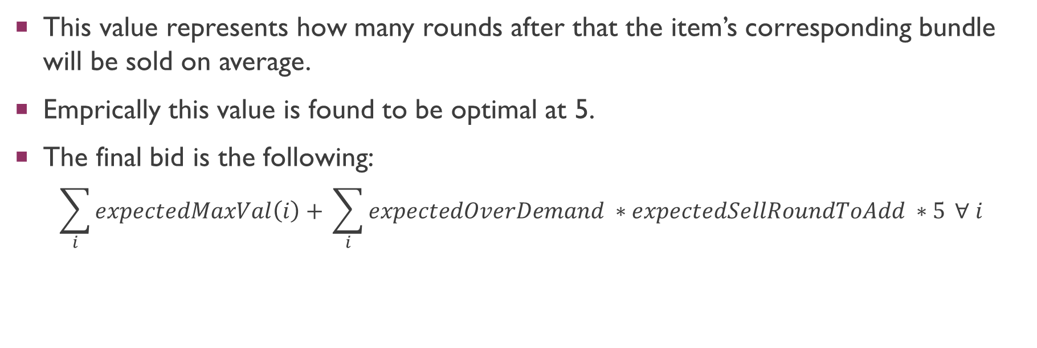
Expected Sell Round to Add
This value represents how many rounds after that the item’s corresponding bundle will be sold on average.
Emprically this value is found to be optimal at 5.
The final bid is the following:
$$\sum_{i}{expectedMaxVal\left(i\right)+ }\sum_{i}{expectedOverDemand ∗expectedSellRoundToAdd ∗5} ∀ i$$

Slide 9
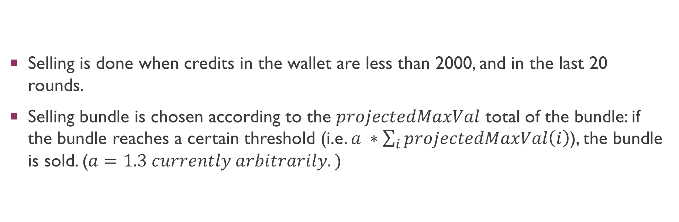
Selling
Selling is done when credits in the wallet are less than 2000, and in the last 20 rounds.
Selling bundle is chosen according to the $projectedMaxVal$ total of the bundle: if the bundle reaches a certain threshold (i.e. $a ∗\sum_{i}{projectedMaxVal\left(i\right)}$), the bundle is sold. ($a=1.3 currently arbitrarily.)$

Slide 10
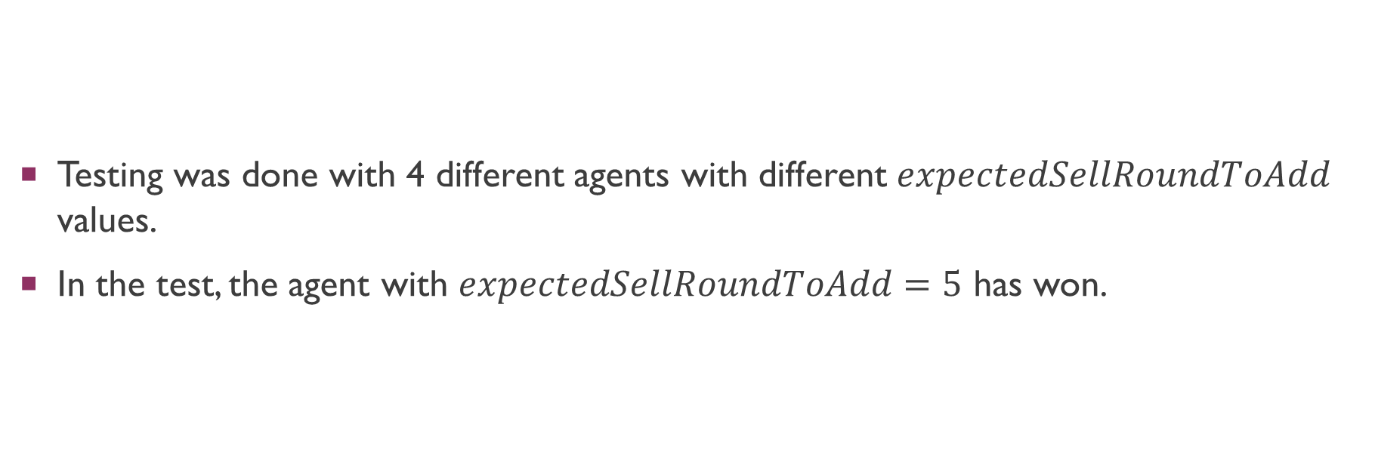
Testing
Testing was done with 4 different agents with different $expectedSellRoundToAdd$ values.
In the test, the agent with $expectedSellRoundToAdd=5$ has won.

